Slide 1
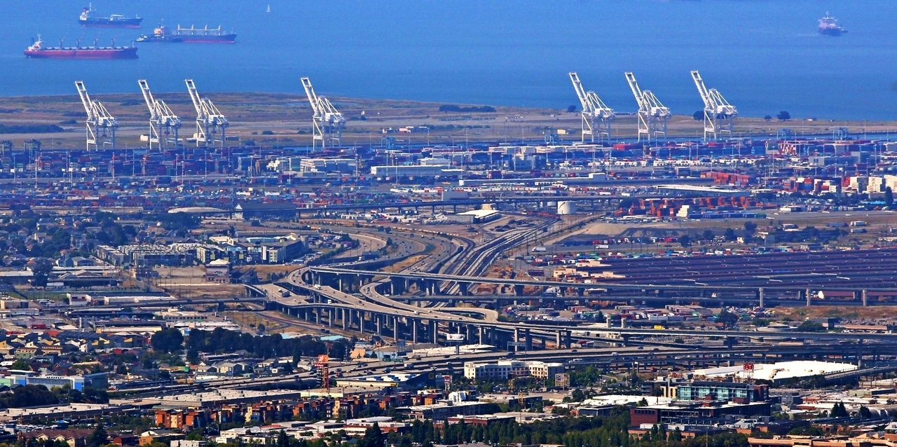
Data Science for Transportation
Dr. Greg Erhardt
261 OHR 859-699-1761 greg.erhardt@uky.edu

Slide 2

Why Data Science?

Slide 3
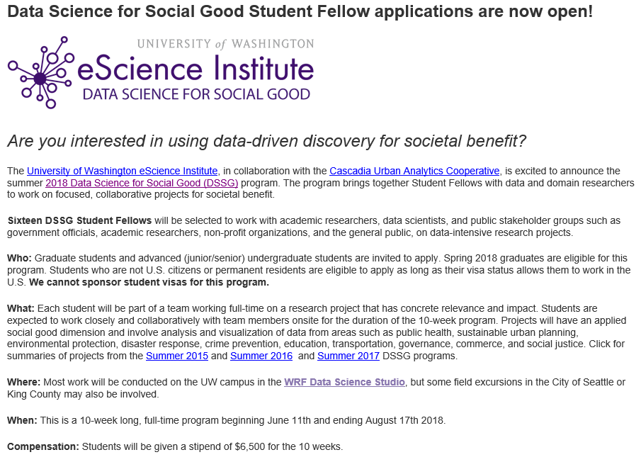
Why Data Science?
http://escience.washington.edu/dssg/

Slide 4
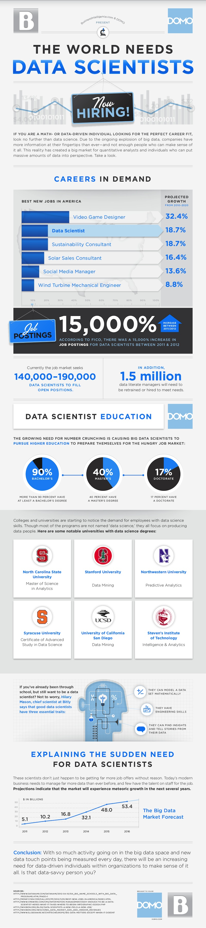
Why Data Science?
http://venturebeat.com/2013/11/11/data-scientists-needed/

Slide 5
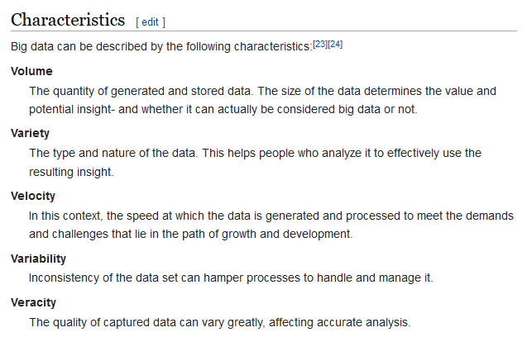
What is Big Data?

Slide 6
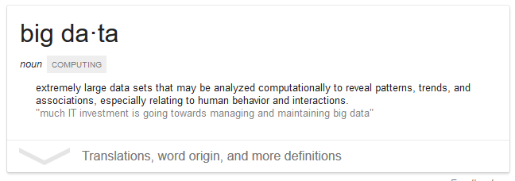
What is Big Data?

Slide 7
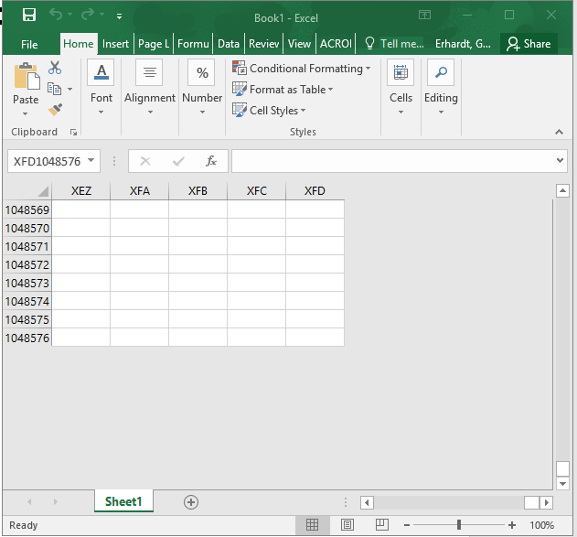
What is Big Data?
Anything that doesn’t fit in an Excel spreadsheet

Slide 8
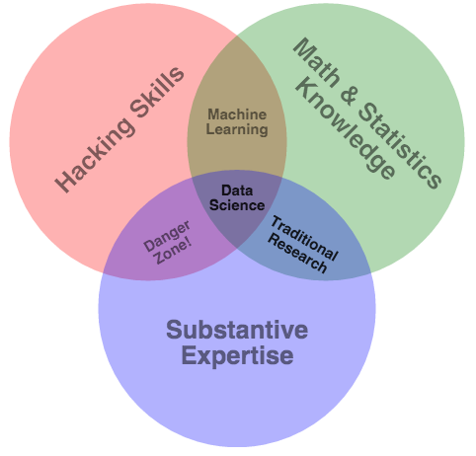
What is Data Science?
http://drewconway.com/zia/2013/3/26/the-data-science-venn-diagram.

Slide 10
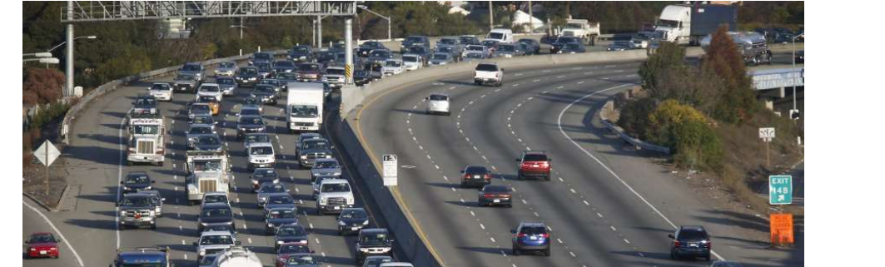
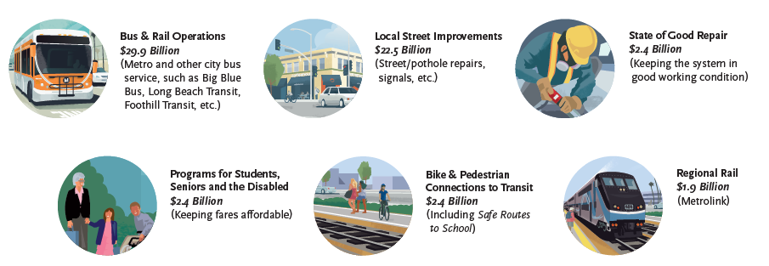
Why Transportation?

Slide 11
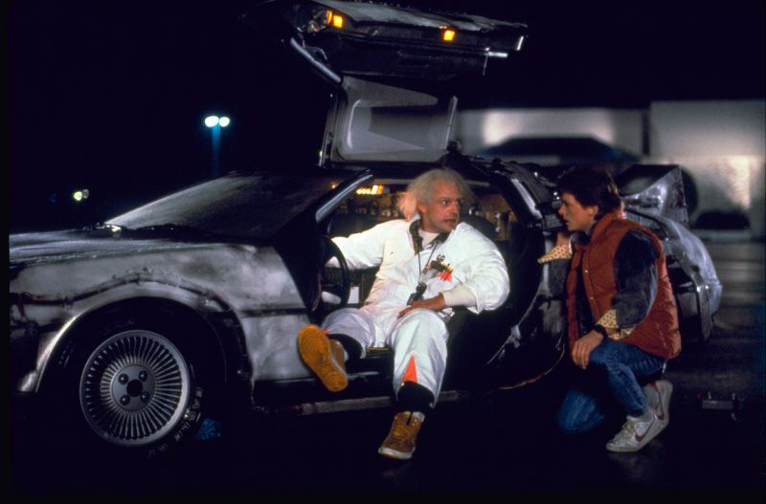
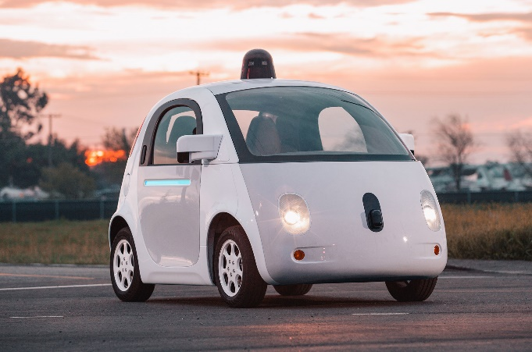
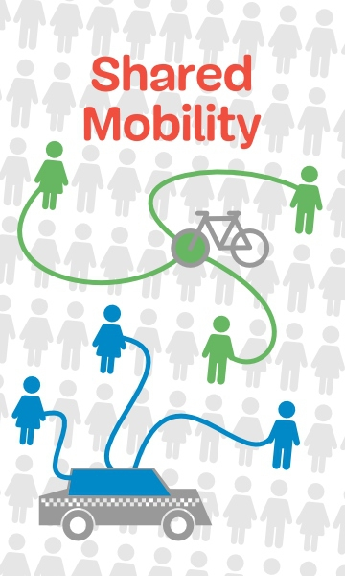

Why now?

Slide 12
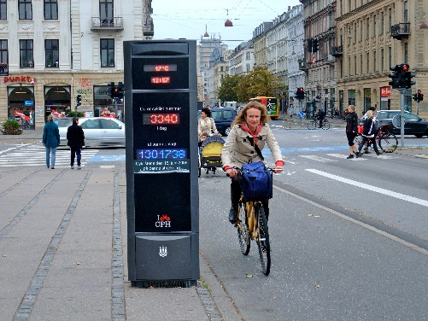
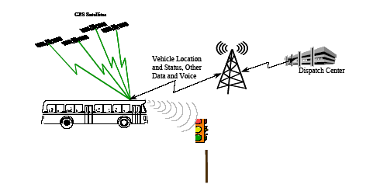
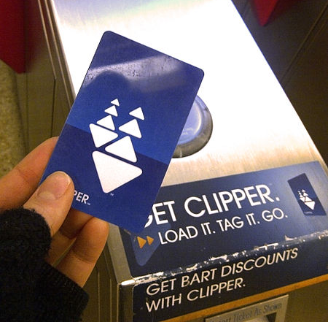
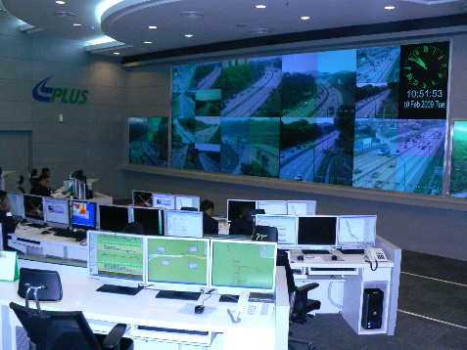
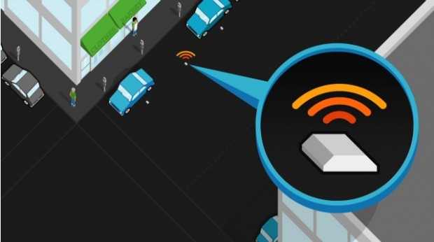
Increasingly, relevant and detailed data are being continuously collected, providing an opportunity to measure the changes that occur in the transport system.
Image from: wikipedia.com
Image from: appliedcomm.com
Image from: commons.wikimedia.org
Image from: commons.wikimedia.org
Image from: sfpark.org

Slide 13


What I do…
What about you?

Slide 14

A note…
I’ve just given you a bunch of hype…
…can you separate the hype from the reality?

Slide 15
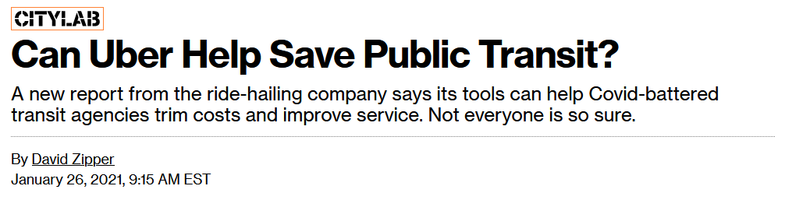

https://www.bloomberg.com/news/articles/2021-01-26/what-to-make-of-uber-s-bid-to-help-public-transit?srnd=citylab

Slide 16
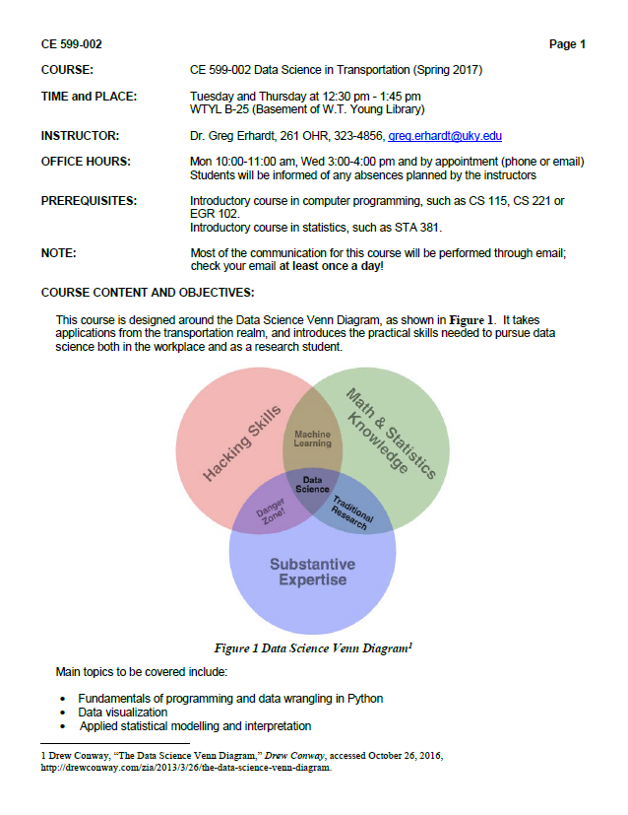
Syllabus & Expectations

Slide 17
Sources of Help
This is a “figure it out” class, not a “sit and listen” class!
Use these resources:
Class time
Text books, Libraries, Librarians
Dr. Google
Peers
Me
We won’t cover everything, but I hope you will start to learn how to “figure it out”

Slide 18
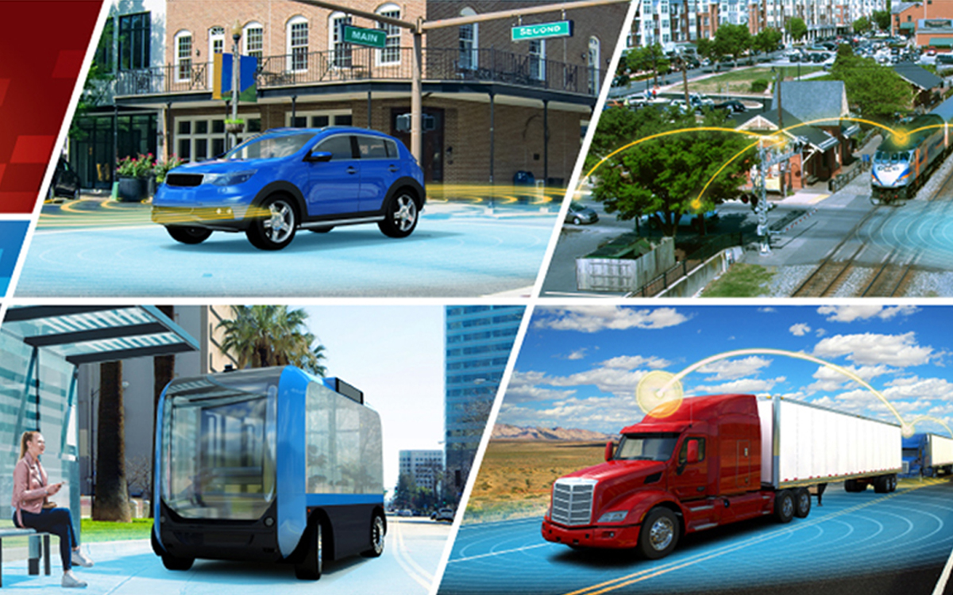
https://github.com/uky-transport-data-science/ce599
Let’s Get Started!

Slide 19
Exercise 1
*1. Install Notepad++ *
A good text editor will be very helpful! Download the installer from here: https://notepad-plus-plus.org/ and familiarize yourself with the basic operation.
*2. Install the Anaconda Python distribution *
Download the Anaconda installer for Python 3.5 from https://store.continuum.io/cshop/anaconda/ (Links to an external site.) Make sure you download the correct installer for your operating system (Windows, Mac, Linux, etc) and architecture (32 or 64 bit). If you don't know if your operating system is 32 or 64 bit, Google for how to check it. And make sure you download the installer for Python 3.5, not 2.7. Run the Anaconda installer. In the Anaconda installer dialog, choose to install for all users, accept the default destination folder (something like c:\anaconda), and make sure both tick boxes are ticked for "add anaconda to the system path" and "register anaconda as the system python" Jupyter Notebook
*3. Read the quickstart guides *
Read the Anaconda QuickStart guide: https://docs.continuum.io/anaconda/install (Links to an external site.) Read the Jupyter Notebook overview: http://jupyter-notebook.readthedocs.io/en/latest/notebook.html (Links to an external site.) (Links to an external site.) If you're not already comfortable with the command prompt (windows) or terminal (mac), read: http://dosprompt.info/ (Links to an external site.) or http://guides.macrumors.com/Terminal (Links to an external site.) to familiarize yourself with the basic commands (such as changing directories and listing the contents of a directory) discussed in these links so that you can use the command prompt/terminal to access Python.

Slide 20
Exercise 1
*4. Test your install *
Open your command prompt (windows) or terminal (mac). If you don't know how, just Google it! run: jupyter notebook You should see the Jupyter server running in your browser. Click "New" > "Python 3" You are now in a new Jupyter notebook. In the first cell, type: print ("Hello World!") Hit shift + Enter to run the cell (it should print Hello World if things are working properly) Take a screenshot and save it to your computer.
*5. Download this notebook *
Go to: https://github.com/uky-transport-data-science/ce599 Use the green button in the top right to download a zip file of the contents, and unzip it on your computer. Look around and see what's in there. Use a command prompt to that folder, and type
jupyter notebook
Open Introduction-to-jupter-notebooks-and-python.ipynb
Work through this notebook. Make sure you can execute each cell by typing Shift-Enter. See if the result is logical, and if you understand what is going on in this cell. As you do this, make a list of three things in the code that you don't understand.

Slide 21
Exercise 1
*6. Create a Github account *
Go to: https://github.com/, create an account, and add a profile picture.
*7. Install Github Desktop *
Go to: https://desktop.github.com/, download it and install it on your computer. Go to File->Options to sign in with your GitHub account, and to enter your name and email address.
*8. Send me an email *
Send the me and the TA email containing:
The "Hello World!" screenshot.
Your list of three things in this notebook that you do not understand.
Your github username.
When we invite you to join our class Github page, please accept.

